Slide 1
System Software

Slide 2
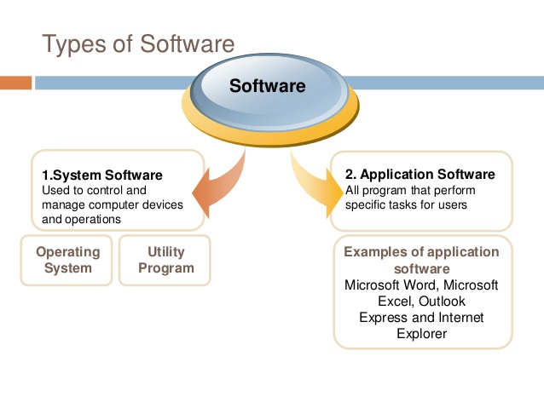
Notes:
Utility software is system software designed to help analyze, configure, optimize or maintain a computer.^{[1]} It is used to support the computer infrastructure in contrast to application software, which is aimed at directly performing tasks that benefit ordinary users.
Although a basic set of utility programs is usually distributed with an operating system (OS), utility software is not considered part of the Operating System and users often install replacements or additional utilities.
Types of utilities[edit]
Anti-virus utilities scan for computer viruses and removes them.
Archivers output a stream or a single file when provided with a directory or a set of files. Archive suites may include compression and encryption capabilities. Some archive utilities have a separate un-archive utility for the reverse operation.
Backup software makes copies of all information stored on a disk and restore either the entire disk (e.g. in an event of disk failure) or selected files (e.g. in an event of accidental deletion).
Clipboard managers expand the clipboard functionality of an operating system .
Cryptographic utilities encrypt and decrypt streams and files.
Data compression utilities output a shorter stream or a smaller file when provided with a stream or file.
Data generators create a file of test data according to specified patterns.
Data synchronization utilities establish consistency among data from a source to a target data storage and vice versa. There are several branches of this type of utility:
File synchronization utilities maintain consistency between two sources. They may be used to create redundancy or backup copies but are also used to help users carry their digital music, photos and video in their mobile devices.
Revision control utilities can recreate a coherent structure where multiple users simultaneously modify the same file.
Disk checkers scan an operating hard drive and check for logical (filesystem) or physical errors.
Disk cleaners find files that are unnecessary to computer operation, or take up considerable amounts of space. Disk cleaner helps the user to decide what to delete when their hard disk is full.
Disk compression utilities transparently compress/uncompress the contents of a disk, increasing the capacity of the disk.
Disk defragmenters detect computer files whose contents are scattered across several locations on the hard disk, and move the fragments to one location to increase efficiency.
Disk partition editors divide an individual drive into multiple logical drives, each with its own file system which can be mounted by the operating system and treated as an individual drive.
Disk space analyzers provide a visualization of disk space usage by getting the size for each folder (including sub folders) & files in folder or drive. showing the distribution of the used space.
File managers provide a convenient method of performing routine data management, email recovery and management tasks, such as deleting, renaming, cataloging, uncataloging, moving, copying, merging, generating and modifying folders and data sets.
Hex editors directly modify the text or data of a file. These files could be data or an actual program.
HTML checkers validate HTML code and checks links.
Memory testers check for memory failures.
Network utilities analyze the computer's network connectivity, configure network settings, check data transfer or log events.
Package managers are used to configure, install or keep up to date other software on a computer.
Registry cleaners clean and optimize the Windows Registry by removing old registry keys that are no longer in use.
Screensavers were desired to prevent phosphor burn-in on CRT and plasma computer monitors by blanking the screen or filling it with moving images or patterns when the computer is not in use. Contemporary screensavers are used primarily for entertainment or security.
Sort/Merge programs arrange records (lines) in a file into a specified sequence.
System monitors monitor resources and performance in a computer system.
System profilers provide detailed information about the software installed and hardware attached to the computer.

Slide 3
System software consists of a variety of programs that support the operation of a computer and manages the resources of a computer system
System Software
System Control Programs System Support Program
Notes:
A system resource is any usable part of a computer that can be controlled and assigned by the operating system so all of the hardware and software on the computer can work together as designed. E.g. Memory,harddisk,CPU,DMA channels,Motheboard

Slide 4
System Control program
Controls the execution of program
Manage the storage and processing
E.g. Operating System, DBMS
System Support Program
Provides routines service function to other computer programs
E.g. Compiler, Interpreter

Slide 5
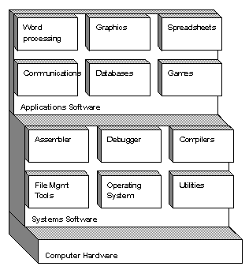

Slide 6
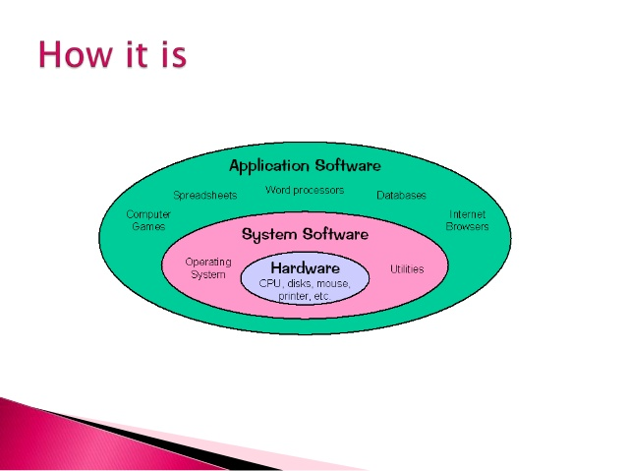

Slide 7
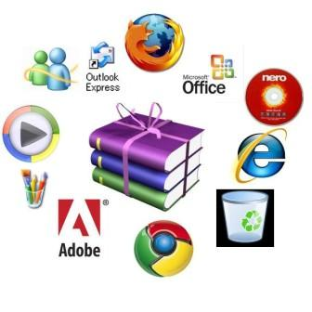
Examples of Application Software

Slide 8
Application Software | System Software
1. Application software is computer software designed to help the user to perform specific tasks. Focus is on application not computing system | 1. System software is computer software designed to operate the computer hardware and to provide a platform for running application software. Focus is computing system
2. It is specific purpose software. | 2. It is general-purpose software.
3. Application Software performs in a environment which created by System/Operating System | 3. System Software Create his own environment to run itself and run other application.
4. It executes as and when required. | 4. It executes all the time in computer.
5. Application is not essential for a computer. | 5. System software is essential for a computer
6. The number of application software is much more than system software. | 6. The number of system software is less than application software.
7. Have good user interface E.g. MS Office | 7. Not user friendly E.g OS,DBMS

Slide 9
Types of System Software
Operating System
Database Management System
Device driver
Text Editor
Macro Preprocessor
Assembler
Compiler
Interpreter
Debugger
Linker
Loader

Slide 10
Programmer
Assembly
Assembler
Program
Compiler
Libraries
Executable code
Linker
Output
Loader
Run
Input

Slide 11
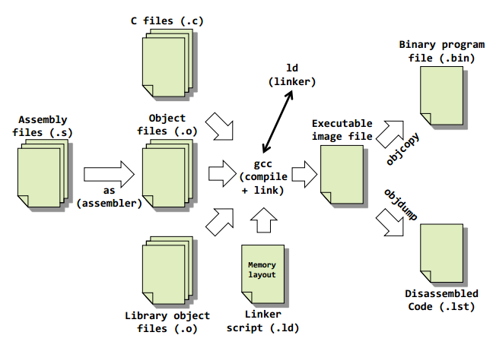

Slide 12
Compiler
Translates a program written in one language (called source language) to an equivalent program in another language (called target language).
Compilers typically translate a high-level source program to a low-level machine language or object code.

Slide 13
Phases of compilation
There are mainly two phases of compilation:
1. Analysis
2. Synthesis
Analysis phase breaks the input program into different constituents called tokens and expressions. This phase ends up creating an intermediate representation of the source program.
Synthesis phase constructs the desired object code from the intermediate representation.

Slide 14
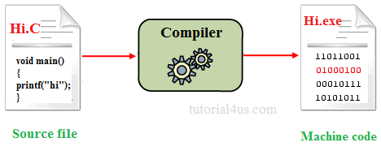
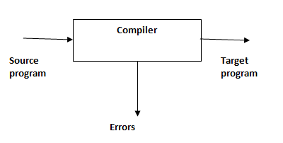

Slide 15
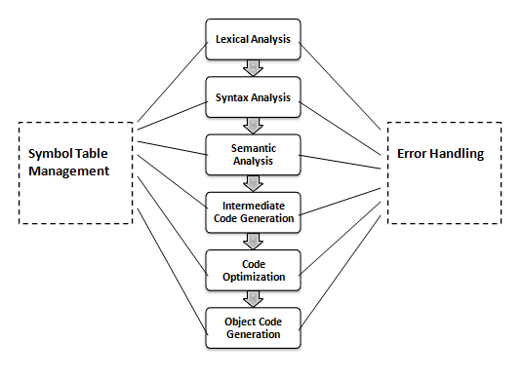

Slide 16
Lexical Analysis: The lexical analysis phase converts the given source program into a sequence of tokens. It may be a
keyword, identifier, punctuation or an operator.
Example: a=b + c*5
The lexical analysis phase converts the above into the following representation:
id1=id2+id3*5;
Syntax Analysis: The syntax analysis phase converts groups of tokens into syntactic structures called expressions. The syntactic structure is usually in the form of a tree where leaves represent tokens and the non-leaf nodes represent operators.

Slide 17
Semantic Analysis: This phase of compilation checks for proper logic of the program. This involves type checking, integer to real conversions etc.
Intermediate Code Generation: The next phase is generation of an intermediate representation of the source program. There are different representations like three-address code, quadruples etc.
Code Optimization: It aims at improving the intermediate code so that the ultimate object code runs faster and may consume less memory.
This involves a variety of activities such as:
Removing unnecessary temporary variables
Move statements that compute to same value outside loops.

Slide 18
Object code Generation: This involves:
Generation of correct addresses to each and every symbol.
Allocation of memory and registers.
Writing machine code to secondary storage as a file.

Slide 19
Interpreter
Interpreter is also a system software that processes a high level source program as its input. interpreter produces an intermediate file as the output
The interpreter parses the source program line-by-line and list out errors as and when they occur. As such, debugging is easier.
The interpreter proceeds to the next line only when the error is corrected.
In this case, object code is not stored and reused.
very time the program is executed, the interpreter translates each instruction freshly.
The interpreter spends less time in processing and analyzing the source program but takes longer time to execute.

Slide 20
Disadvantages
1. Instructions repeated in program must be translated each time they are executed.
2. Because the source program is translated fresh every time it is used, it is slow process or execution takes more time. Approx. 20 times slower than complier.

Slide 21
Macroprocessor
Macro: A set of instructions that is represented in an abbreviated format
A macro is a fragment of code which has been given a name. Whenever the name is used, it is replaced by the contents of the macro.
Macros are commonly used to write programs in an easy and convenient manner.
Repeatedly used lines of code can be defined using a macro instruction or simply, a macro.
During program compilation, the macro processor replaces the macro instruction with the body of the macro.
Arguments can also be passed as in case of functions.

Slide 22
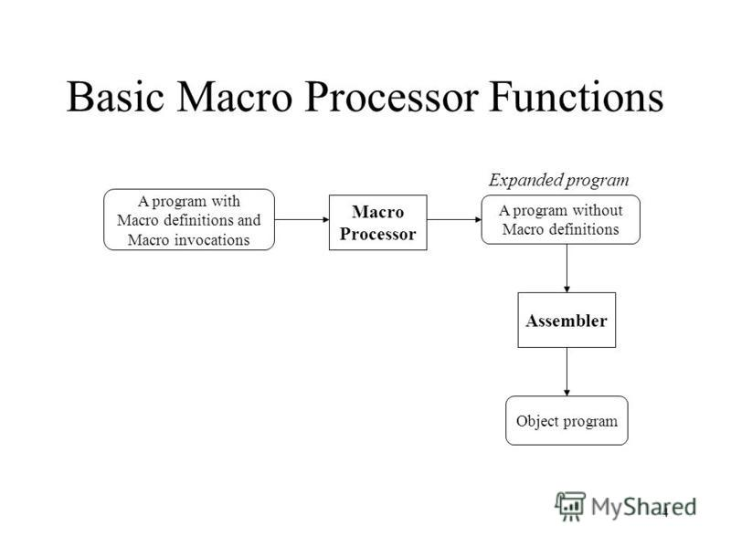

Slide 23
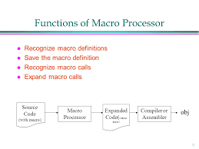

Slide 24
Example:
READ MACRO &inp _dev, &data
Loop1: TD inp_ dev
JEQ Loop1
RD inp dev
STCH data
MEND
The above macro can be invoked by using the statement:
READ F1, BUFFER
where F1 is the hex code of the input device to read the data from and BUFFER is the location to store data.

Slide 25
Assembler
Assembler language or assembly language, the closest translation to machine code so humans may work on more comfortably:
Assembler (computing), a computer program which translates assembly language to an object file or machine language format.
Assembler performs two passes on the input.

Slide 26
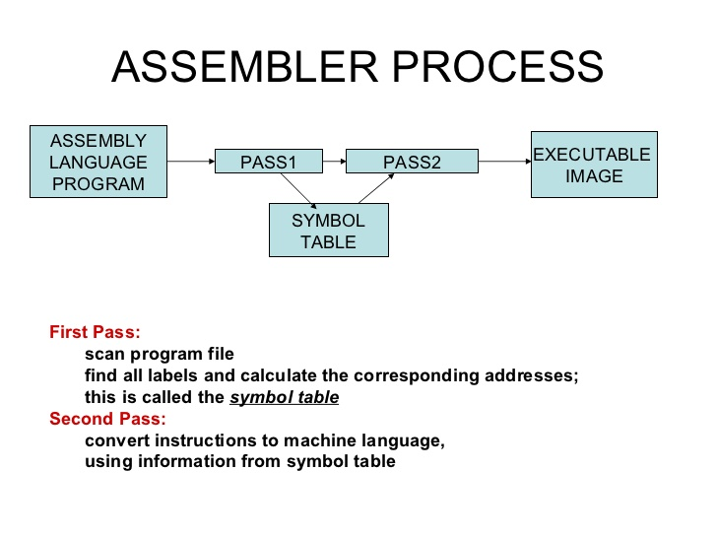

Slide 27
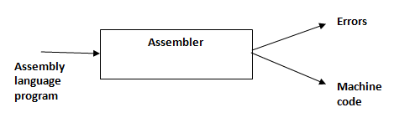

Slide 28
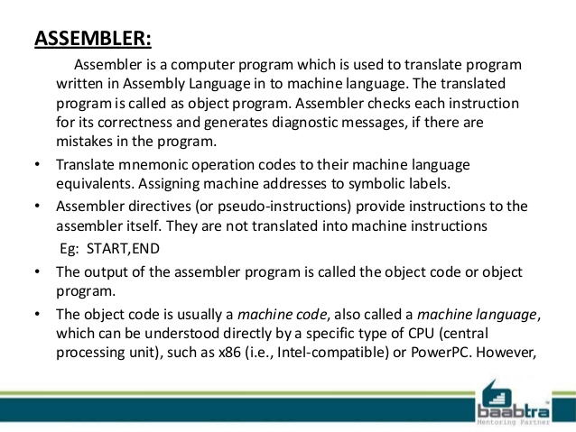

Slide 29
In the first pass, analysis of the source program takes place.
All the statements are assigned addresses.
Save the symbols and corresponding address values in a data structure called SYMTAB or symbol table.
Performs processing of the following assembler directives:
START- Name and starting address of the program
END- Indicate end of the source program and optionally species the address of the first executable instruction.
BYTE- Generate a character
WORD- Generate one word which is 3 bytes in SIC machine.
RESB- Reserves indicated number of bytes.
RESW- Reserves indicated number of words.
OPTAB or the operation code table is used to lookup operation codes and validate them.

Slide 30
Pass 1 usually generates an intermediate file that contains each source statement together with their assigned addresses.
During pass 2:
symbols are looked up in SYMTAB and their addresses are inserted into the final object code listing.
Mnemonic opcodes are also translated to machine code.
The output of an assembler is listed in the form of different record types namely, Header, Text and End records.

Slide 31
Header Record
Col 1: H
Col 2-7: Program Name
Col 8-13: Starting address (Hexadecimal)
Col 14-19 Length of object program in bytes
Text Record
Col1: T
Col2-7: Starting address for object code in this text record
Col8-9: Length of object program in bytes
Col 10-69 Actual object code (Hexadecimal)
End Record
Col1: E
Col2-7: Address of first executable instruction (optional)

Slide 32
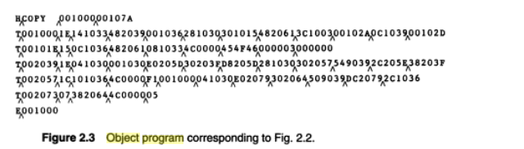
Note: No object code generated for assembler directive like RESW,RESB in the source program

Slide 33
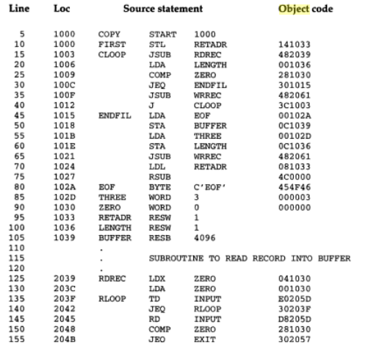

Slide 34
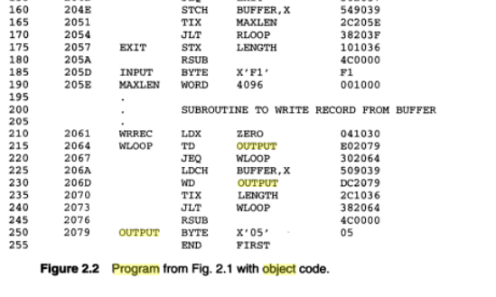

Slide 35
Linker
Linker is a system software that helps us to use shared library routines.
Shared library routines are dynamically linked to actual addresses only when they are first invoked.
According to a linker, a program is just a logical collection of independent object modules called control sections.
The function of a linker is to link all such independent modules to actual addresses in memory ready for loading
by a loader.

Slide 36
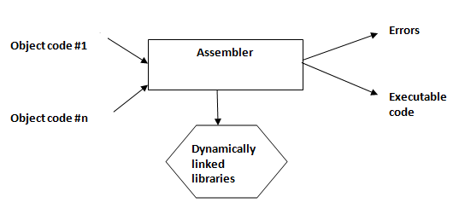

Slide 37
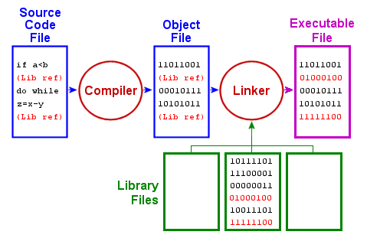

Slide 38
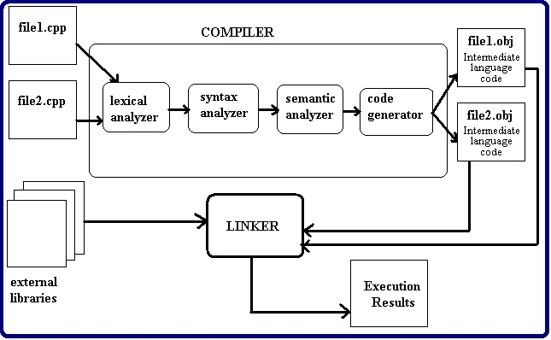

Slide 39
Loader
Loader loads the executable program produced by the linker from the secondary storage to the primary memory for execution.
loader is a part of the OS itself.
Relocatable addresses are built at this stage.
The header record is checked to verify that the correct program has been presented for loading
Text record is read , the object code it contains is moved to the indicated address in memory
When end record is encountered the loader jumps to the specified address to begin execution

Slide 40
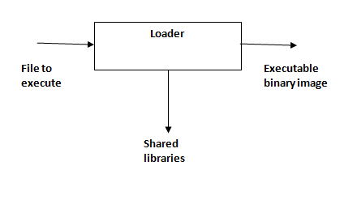

Slide 41
Operating System
Operating System is a system software that makes the computer easier to use.
It provides a user-friendly interface that hides the details of underlying hardware.
The operating system manages the resources of the computer.
The basic function of an OS is to provide a set of services to the user program, so that the program can invoke that service routines and the OS could perform the requested operation at the machine-level.

Slide 42
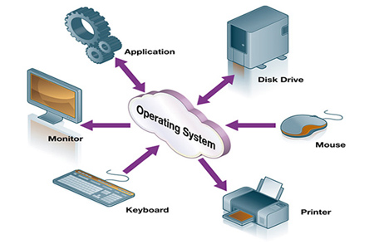

Slide 43
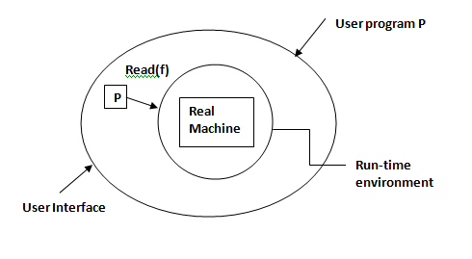

Slide 44
Functions of OS
Interrupt handling
Process scheduling
Memory management
Virtual memory management
File processing
Resource allocation

Slide 45
Database Management Systems (DBMS)
A database is an integrated collection of logically related records or objects.
DBMS is a system management software that coordinates and manages databases.
Database helps to eliminate two main problems associated with conventional file processing systems namely, data redundancy and data dependency.

Slide 46
A database management system (DBMS) is a collection of programs enabling users to create and maintain a database.
More specifically, a DBMS is a general purpose software system facilitating each of the following (with respect to a database):
definition: specifying data types (and other constraints to which the data must conform) and data organization
construction: the process of storing the data on some medium (e.g., magnetic disk) that is controlled by the DBMS
manipulation: querying, updating, report generation
sharing: allowing multiple users and programs to access the database "simultaneously"
system protection: preventing database from becoming corrupted when hardware or software failures occur
security protection: preventing unauthorized or malicious access to database.

Slide 47
Text editor
Text editors are often provided with operating systems and software development packages.
It can be used to change configuration files, documentation files and programming language source code.
Features
Find and replace
Cut, copy, and paste
Undo and redo
Syntax highlighting
Example: Vi Editor for Linux , TextPad for windows

Slide 48
Debugger
Debuggers are software tools which enable the programmer to monitor the execution of a program , stop it, restart it, set breakpoints, and change values in memory.
Testing finds errors; debugging localizes and repairs them.
debugging is an action that results in the removal of the error
An interactive debugging system (IDS) provides programmers with facilities that aid in testing and debugging of programs.
Example: GDB-GNU debugger.

Slide 49
What can debuggers do?
Run programs
Make the program stops on specified places or on specified conditions
Give information about current variables’ values, the memory and the stack
Let you examine the program execution step by step - stepping
Let you examine the change of program variables’ values - tracing

Slide 50
A Debugging system should also provide functions such as tracing and trace back.
Tracing can be used to track the flow of execution logic and data modifications. The control flow can be traced at different levels of detail – procedure, branch, individual instruction, and so on
Traceback can show the path by which the current statement in the program was reached. It can also show which statements have modified a given variable or parameter.

Slide 51
Device Driver
A device driver is a program that operates or controls a particular type of device that is attached to your computer.
A driver provides a software interface to hardware devices, enabling operating systems and other computer programs to access hardware functions.
There are device drivers for printers, displays, CD-ROM readers, diskette drives, and so on.
When you buy an operating system, many device drivers are built into the product.

Slide 52
A driver typically communicates with the device through the computer bus or communications subsystem to which the hardware connects.
When a calling program invokes a routine in the driver, the driver issues commands to the device.
Once the device sends data back to the driver, the driver may invoke routines in the original calling program.

Slide 53
Thank You!!

